Slide 1
Redbus Data Scraping with Selenium & Dynamic Filtering using Streamlit

Slide 2
Objective & Problem Statement
PROBLEM STATEMENT
The transportation industry, especially bus travel, requires efficient data management to optimize routes, schedules, pricing, and seat availability.
CHALLENGES
Manual data collection is time-consuming and prone to errors.
Lack of real-time data makes it hard to make timely decisions.
Inefficient data analysis tools hinder strategic planning and operational efficiency.
AIM
To develop an end to end solution for collecting, analyzing, and visualizing bus travel data from Redbus, by using Selenium for web scraping and Streamlit for data visualization.

Slide 3
Steps
Data scrapping using Selenium.
Data storage in SQL database.
Streamlit application development.
Data Analysis and filtering using Streamlit.

Slide 4
Webscraping with Selenium(automating data extraction from web page)
Tools used: Selenium for Webscraping , Pandas for data manipulation.
Extract bus route information from a paginated web page and save it into a CSV file.(for 10 state transportations)
Steps
Initialization.(chrome web driver)
Navigating pages(wait for pagination table EC)
Locate page tab and click matching page number.(find elements)
Wait for new content to be loaded on the page.(EC)
Loop through pages.(extract links and routes)
Data Storage(extracted data to a DataFrame).
Save df to csv file.
Close webdriver to free resources.(driver.quit)

Slide 5
Webscraping with Selenium(automating data extraction from web page) contd….
To extract Detailed Bus Information(seat availability,fare,arrival and departure time,rating,bus name,bus type,duration) from Multiple URLs.
Steps
Reading Input Data(load URLs and bus routes from a CSV file into a DataFrame).
Initialization( chrome webdriver)
Loop through each row in the DataFrame, extracting the URL and bus information.
Scroll to load all content(action chains driver)
Extract required bus details and converted to DataFrame.
Concatenate all individual DataFrames into a single DataFrame and save to CSV.

Slide 6
Data Storage in SQL database
Storing Web Scraped Data into MySQL Database.
Tools used
Pandas for data manipulation.
PyMySQL for database connection.
Python for automation.
Establish a connection to the MySQL server with the provided credentials and database name.
Read the CSV file in to a dataframe and drop rows with NaN values.
Ensure the data columns are correctly formatted.
Map Pandas data types to MySQL data types for table creation.
Generate the formatted string for the CREATE TABLE SQL query.
Create table and Insert data row by row into the created table.
Commit changes and close connection.

Slide 7
Data Analysis and filtering using Streamlit Application
A Streamlit-based interactive data filtering tool.
Technologies used: Streamlit(creating web application), pandas(data manipulation), PyMySQL(connecting to and querying MySQL database).
The script connects to a MySQL database, executes queries, and displays filtered data.
Users can filter bus data based on type, route, price range, rating, and seat availability.
Generate SQL Queries Based on Filters.
Streamlit Application Layout(sidebars, Creates filters for bus type, route, price range, rating, and seat availability, Generates and executes the SQL query based on user-selected filters, Displays the filtered data in the main area)

Slide 8
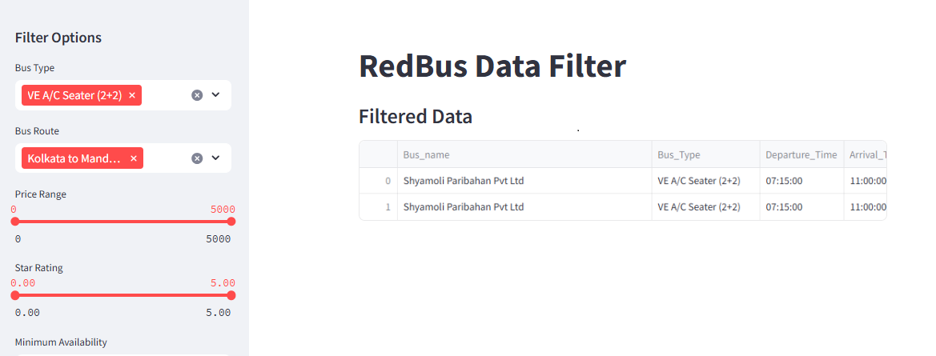
Filtered Data

Slide 9
THANK YOU

